Slide 1
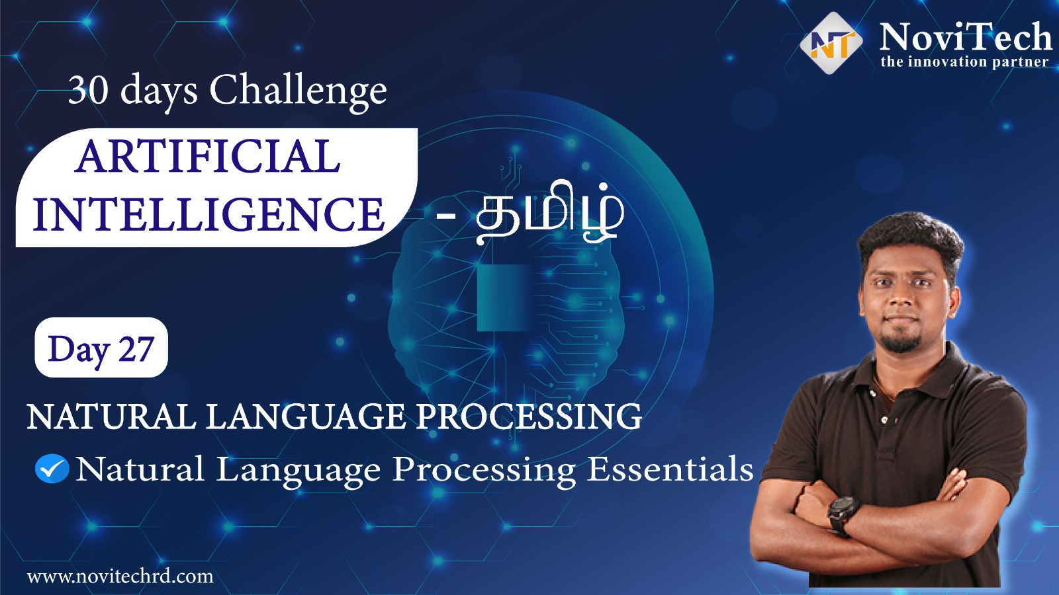

Slide 2
Announcement
2 Times Attendance link will be shared in between the session at the end of the session
Minimum 25 Days Attendance required to receive your FREE E-CERTIFICATE (with same mobile number & email id)

Slide 3
Prerequisites for this Course
Laptop with Good Internet
No basic knowledge is required.
Note & Pen

Slide 4


Natural Language Processing
Overview

Slide 5

Post Your 1st Half Attendance

Slide 6
Natural Language Processing
Overview

Slide 7


Solution - Internship
30 Day Recorded Video Lectures (₹4000)
20+ Projects (₹30,000)
Bonus Task, Assignments (₹1,500)
Technical Material(PPT, Mindmap) (₹1,000)
Rs.40,000
100 AI Interview Questions(1500)
Rs.1,999
Hand Signed Printed Certificate For Internship with your Photocopy (₹2,000)
Live Q&A Session on next 5 Saturdays
Lifetime Course Validity

Slide 8
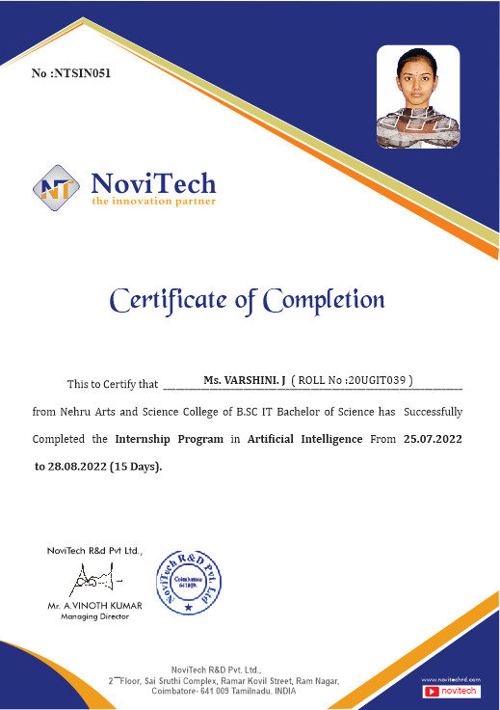

Slide 9
Mindset of the Day
I am Stuck – Your are not stuck(You can always take the smallest possible step to get you out of where you are right now

Slide 10
Post Your 2nd Half Attendance

Slide 11




THANK YOU☺
NOVITECH COIMBATORE
novitechresearchanddevelopment

Slide 12
Q & A Session?

